Slide 1
CONSTRAINTS,
DISCOVERABILITY

Slide 2
CONSTRAINTS

Slide 3
Constraints
How do we determine how to operate something that we have never seen before? We have no choice but to combine knowledge in the world with that in the head.
Knowledge in the world includes perceived affordances and signifiers, the mappings between the parts that appear to be controls or places to manipulate and the resulting actions, and the physical constraints that limit what can be done.
Knowledge in the head includes conceptual models; cultural, semantic, and logical constraints on behavior; and analogies between the current situation and previous experiences with other situations.

Slide 4
Constraints
The sizes and shapes of the parts suggested their operation. Physical constraints limited what parts would fit together.
Cultural and semantic constraints provided strong restrictions on what would make sense for all but one of the remaining pieces, and with just one piece left and only one place it could possibly go, simple logic...

Slide 5
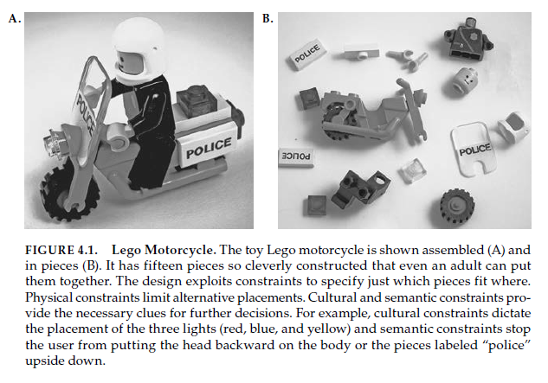

Slide 6
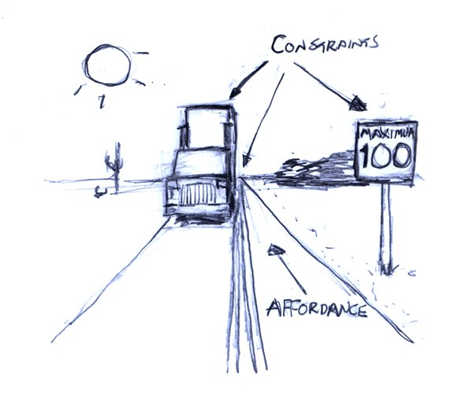
Constraints
4 classes of constraints seem to be universal, appearing in a wide variety of situations:
physical
cultural
semantic
logical
Constraints are powerful clues, limiting the set of possible actions.
The thoughtful use of constraints in design lets people readily determine the proper course of action, even in a novel situation.

Slide 7

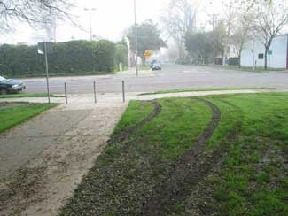

Slide 8
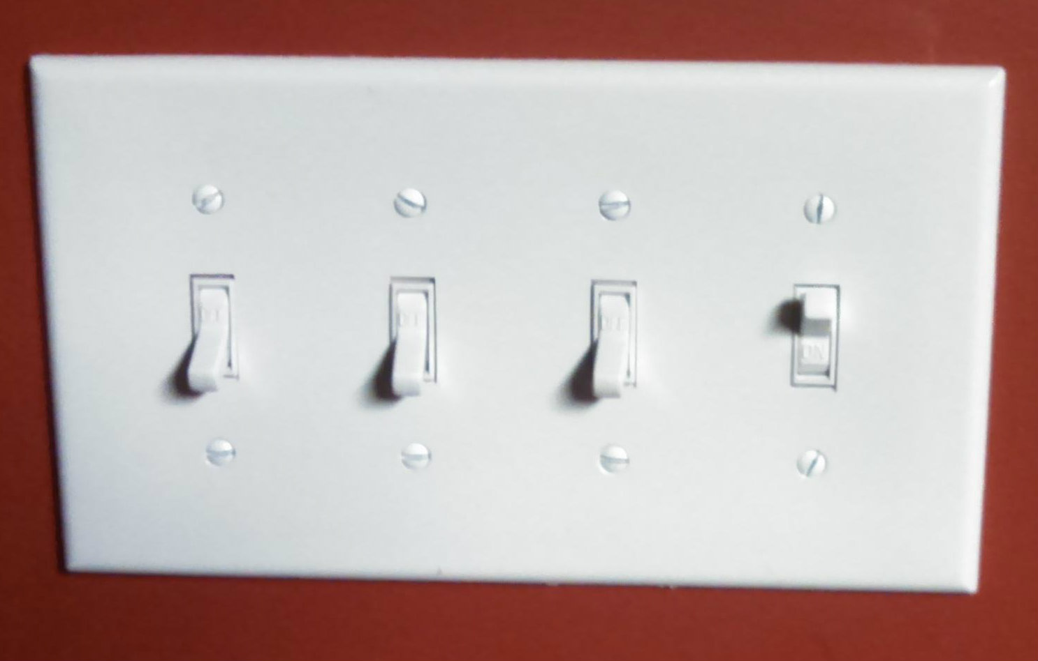
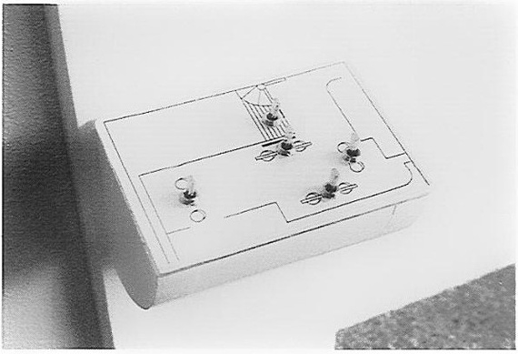
Lack of constraints and mapping
The lack of clear communication among the people and organizations constructing parts of a system is perhaps the most common cause of complicated, confusing designs.
A usable design starts with careful observations of how the tasks being supported are actually performed, followed by a design process that results in a good fit to the actual ways the tasks get performed.

Slide 9
Constraints That Force the Desired Behavior

Slide 10
FORCING FUNCTIONS
Forcing functions are a form of physical constraint: situations in which the actions are constrained so that failure at one stage prevents the next step from happening.
Forcing functions are the extreme case of strong constraints that can prevent inappropriate behavior.
Not every situation allows such strong constraints to operate, but the general principle can be extended to a wide variety of situations.

Slide 11

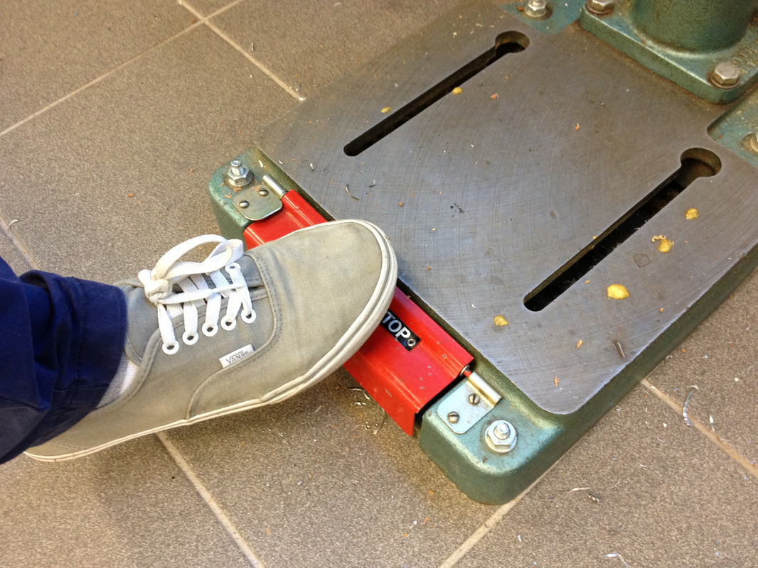
FORCING FUNCTIONS: INTERLOCKS
An interlock forces operations to take place in proper sequence.

Slide 12
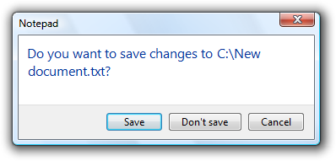
FORCING FUNCTIONS: LOCK-INS
A lock-in keeps an operation active, preventing someone from prematurely stopping it.
Standard lock-ins exist on many computer applications, where any attempt to exit the application without saving work is prevented by a message prompt asking whether that is what is really wanted
These are so effective that people uses them deliberately as standard way of exiting. Rather than saving a file and then exiting the program

Slide 13

FORCING FUNCTIONS: Lockout
Whereas a lock-in keeps someone in a space or prevents an action until the desired operations have been done, a lockout prevents someone from entering a space that is dangerous, or prevents an event from occurring.

Slide 14
ACTIVITY-CENTERED CONTROLS

Slide 15
Activity-centered design (ACD) is an extension of the Human-centered design paradigm in interaction design.
ACD features heavier emphasis on the activities that a user would perform with a given piece of technology.
ACD has its theoretical underpinnings in activity theory, from which activities can be defined as actions taken by a user to achieve a goal.
It’s important to note that ACD is a model, not a process. ACD is just one of many perspectives you can employ when designing.

Slide 16
Activity-Centered Controls
Spatial mapping [of switches] is not always appropriate.
In many cases it is better to have [switches] that control activities: activity-centered control.
Many auditoriums in schools and companies have computer-based controls, with switches labeled with such phrases as “video,” “computer,” “full lights,” and “lecture.”

Slide 17
Activity-Centered Controls
Activity-based controls are excellent in theory, but the practice is difficult to get right. When it is done badly, it creates difficulties.
Activity-Centered Controls must be User-Activity-centered
A related but wrong approach is to be device-centered rather than user-activity-centered.
When they are device-centered the user would need to know the technical model behind the system!

Slide 18
https://www.myharmony.com/en-en/
“To program the Harmony, I simply went to their website, selected the brand and model number of all the equipment I owned (and yes, they had every item), and then connected my remote to the computer via the convenient USB cord. In a matter of minutes, my remote was programmed.”
https://jnd.org/activity-centered_design_why_i_like_my_harmony_remote_control/

Slide 19
I still use the specialized remotes, because specialization always beats general purpose devices. But I use the Harmony to set up, to change activities, and at the end, to turn off the equipment. Once in an activity, however, then I usually prefer to use the specialized controller, with its joystick or wheel, for quite often the physical controls of the specialized remote are superior to the general purpose ones of the harmony. But getting to that point is where the difficulty arises, and this is the problem the Harmony solves.
So, I use the harmony to select the activity and setup all the equipment to the proper state. Then I get the one remote specialized for the device -- TiVo, Satellite receiver, or DVD player. And the remote for the lights. And then I am truly happy. When finished, I pick up the harmony and one button push turns off all the equipment (see note).

